Slide 1
Crowdfunding Group-2
Gowtham nallamothu
ANUSHREE
Anoop Kumar Jha
Ismath Tabassum
Zaroon Anis Dhukka

Slide 2
Introduction to crowdfunding
Crowdfunding is a method of raising capital through the collective efforts of a large number of individuals.
It leverages social networks and the internet to connect project creators with potential backers.
This approach democratizes funding, allowing startups and projects to gain financial support without traditional investors.

Slide 3
Types of crowdfunding
The main types of crowdfunding include donation-based, rewards-based, equity-based, and debt-based crowdfunding.
Donation-based crowdfunding allows individuals to contribute without expecting any financial return.
In equity-based crowdfunding, backers receive shares of the company in exchange for their investment.

Slide 4

Total number of projects

Slide 5

Total number of projects by state(successful)

Slide 6

Total number of projects by country(us)

Slide 7


Total number of projects by category_id

Slide 8


Total number of projects by year,month,quater

Slide 9

Amount raised

Slide 10

Number of backers

Slide 11

Average number of days

Slide 12

Backers count by project

Slide 13

Amount raised by project

Slide 14

Percentage of successful

Slide 15


Percentage of successful projects

Slide 16
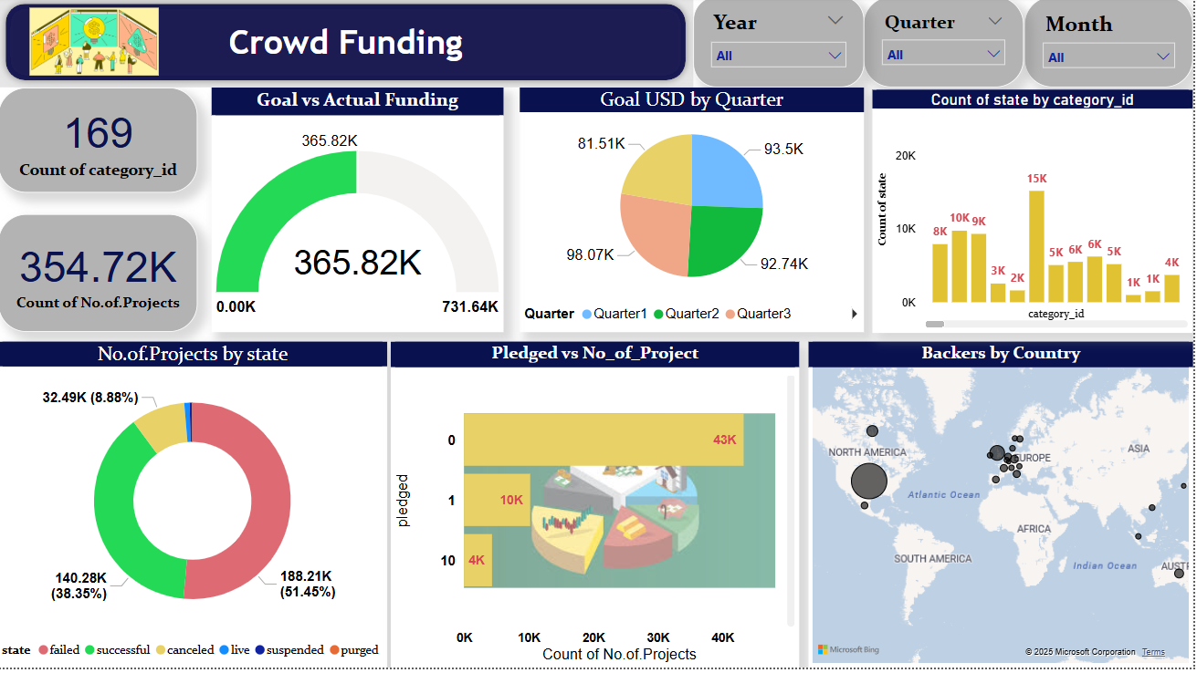

Slide 17
